Slide 1
Lyons Document Storage Case
By: Jacob Baron, Ben Hoffman, Lucas Lantis, and Reid Zuerlein

Slide 2
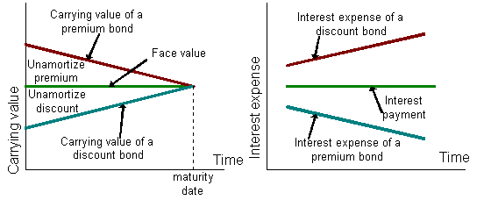
Premium vs. Discount
Premium Bonds
Coupon rate > prevailing market interest rate
Present value > face value
Discount Bonds
Prevailing market interest rate > coupon rate
Face value > present value

Slide 3
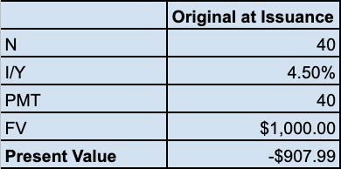
Amount Received at Issuance
$10 million bond, 8% coupon rate, 20 years remaining, interest paid semi-annually
Prevailing market interest rate = 9%
(In ten thousands)

Slide 4
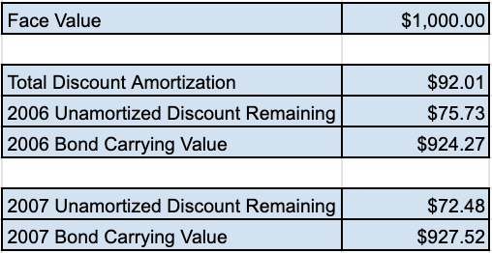
2006 & 2007 Carrying Value
Total amount amortized at year end:
2006: $162,749
2007: $195,305
Bond Carrying Value:
2006: $9.2427 million
2007: $9.2752 million

Slide 5
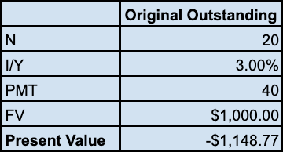
Current Market Value of Bonds Outstanding
$10 million bond, 8% coupon rate, 10 years remaining, interest paid semi-annually
Prevailing market interest rate = 6%

Slide 6
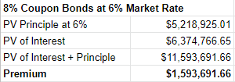
Recommendation
If the old bonds are refunded at $1,154.15 (given), the value of the old bonds is therefore $11,541,000. The call premium is $1,541,000.
Calculated the premium of “new” bonds with a coupon rate of 8% and a market rate of 6%
Since the new bonds have a higher premium, then Rene should refund the old bonds and issue new bonds at a lower market rate.

Slide 7
Recommendation (Cont.)
If the current market rate is 6% and the coupon rate is 8%, with semi-annual compounding, that bond should be selling for $1,159.37.
Rene will need to issue 9,955 bonds to cover the cost of refunding the old bonds at $11,541,000. Issuing new bonds will be cheaper in the long run since they are at a lower rate.

Slide 8

Scenario Analysis
If 6% bonds could be issued, they would be trading at par because the market interest rate is 6%.
Bonds would therefore be selling at par ($1,000)
We would recommend Rene issuing 11,541 of these bonds to have enough proceeds to refund the existing bonds

